Slide 1

Social Media Marketing
Ethan Boey, Dominic, Luke, Ruo Chen, Hong Ray

Slide 2

Introduction to digIT
We are a Social Media Marketing company
Help businesses create a strong brand identity
Via Social Networks and Professional Public Relation Strategies
We want more to like our Clients brand
Predictable sales-driven strategies result in massive growth of revenue
Our Services will solve our clients marketing problems
Services such as social media marketing, web analytics, search engine optimization, digital advertising, content marketing and email marketing, Online marketing optimization and web design and development

Slide 3
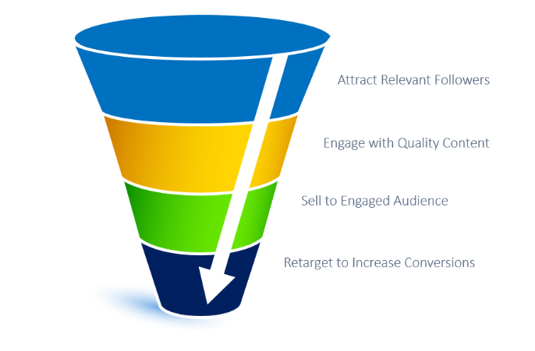
Purpose of Website
Give Information to businesses about what we do as a Social Media Marketing Company and how we can benefit their businesses.
Provide services to business through the use of social Media by promoting their businesses.
Give an insight to companies who are looking to promote to business through the use of Social Media.

Slide 4
Task Allocation
Home Page - Ethan Boey
Our Services - Hong Ray
About Us - Ruo Chen
Our Clients - Luke
Contact Us/Form submitted - Dominic

